Slide 1
Lecture 6: Fundamentals of Web Development

Slide 2
What is the web, and how does it work?
Notes:
Our first topic today is a quick overview of how the web actually works. While we all know how to use it, there’s a whole process that we don’t really have to think about as users but that’s very important to think of as developers.

Slide 3
The Core Process of the Web
At the end of the day, the web is all about the communication of ideas. Everything in the web can be seen as a request and a response
When you go to a news website, you’re requesting news and receiving news in response.
When you go to a shopping website, you’re requesting product information and receiving relevant information.
When your server receives input, it determines what to do with that input and outputs the proper response.
Your duty as a web developer is to make that communication possible. Your programs will get a request and give a response, and allow that communication to occur as smoothly as possible.
Notes:
The first thing we have to understand in web programming out is what actually happens when we use the web?
Everything accessible on the internet follows a very simple pattern: somebody (or something, like a program) makes a request, and a server returns a response. Most problems we will face in web programming can be seen as a sort of handshake: you will look at what data you have and know, and figure out how to turn that into what data you need it to become.
A request is some form of a question. When we go to a web page, we’re actually sending a server somewhere a request to receive some sort of data. Your job as a web programmer is to figure out how to work facilitate this communication between users and the data they want. You’re essentially acting as a translator for people to get the information that they’re looking for. The web is all about communication, even in its programming.

Slide 4
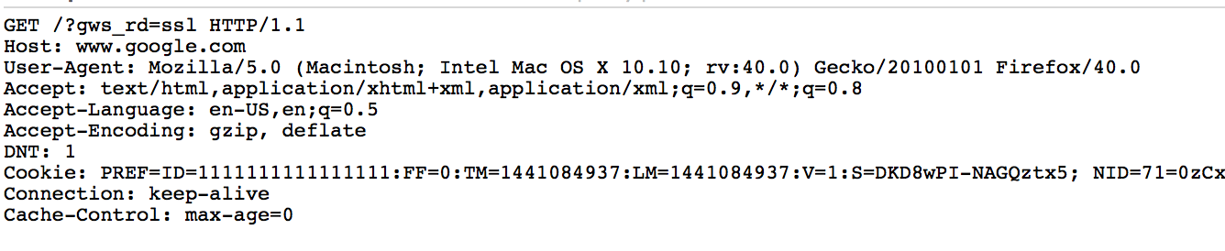
The request
Every time you navigate to a website, your browser sends a request on your behalf to the server.
There is a lot to an HTTP request! https://developer.mozilla.org/en-US/docs/Web/HTTP
Each request follows a standardized process! https://www.w3.org/wiki/How_does_the_Internet_work
Every request is formatted in a specific way, with the same data provided on each request.
A request to http://google.com/ would look like:

Slide 5
Parts of that request
HTTP Verb signifying what action you are trying to (GET POST PUT DELETE)
The server you want to connect to (the HOST)
The location of the resource you want to access on that server (the location)
Headers
Headers are metadata about your request
These include cookies!
Notes:
While we’re not actually programming in the backend yet and dealing with sending requests and receiving responses, it’s important to have an understanding of what’s inside of a request. Keeping this in the back of our minds will make things much easier later on down the line.
When a user navigates to a url, the browser composes a request to send to a server on the user’s behalf. This request has a bunch of data, such as what page the user is asking for, what type of content the user expects to get back, and other data such as cookies that the server may have sent to the user.
On the right side of this slide, I’ve included a request from my computer to Google’s home page.

Slide 6
What does the server do with that info?
The server reads that request and determines what needs to be done in order to generate a response that makes sense for the data that the server has been given.
The server uses data sent in the request in order to generate a response.
Some common types of data in a request that servers use are:
Querystring params
Headers
Cookies
Request body
Notes:
When the server gets a request, it has to interpret it and figure out what to do with that requests. Request from any browser will always come in the same format, but each server has its own way of handling these requests. Some part of the server has to take in that raw, plain request and turn it into a format that’s readable and understandable by the code on the server so that a response can be generated.
These requests contain all sorts of data for the programmer to account for, such as parameters that should be passed into the code (often signified in something called querystring params), or headers that describe the request for data. Cookies are a very important type of header that signify some sort of data that the server has told the browser to remember for the user such as a user id, or a language to show the website in.
Finally, and very importantly, the request can contain some sort of content of its own; it can send a message to the server in the request’s ‘body’ area, which is the data that the request wants the server to be aware of. This is a fundamental component to how the web works.

Slide 7
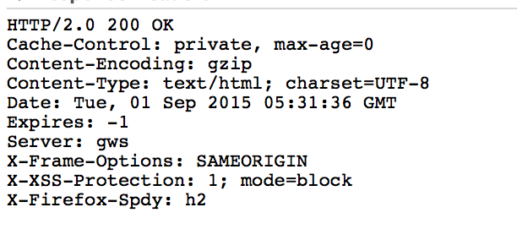
The response
The server sends back a response that is similar to the request. It contains:
A status code
Indicates whether or not the operation succeeded
A set of headers
Cookies, data about the response such as content type
This is often “meta-data” about the response.
Some form of response body:
An HTML Document
A JSON response
A File Stream
Plain Text
Etc.
Notes:
The server’s response looks very similar to the request, but looks nothing like what the user will see. To the right, we see the response that our request to Google sends back.
Let’s go to the terminal and see that response’s body, too:
$ curl -D - https://www.google.com/
As you can tell, that’s a lot harder for most people to understand than what we see when we go to Google’s home page.
A server will send back a status code with the response, which is a number that signifies how the request was met. You’ll commonly see a 200 status code to mean that the request was understood, valid, and that a response was able to be generated. A famous status code is 404, which means that the server could not find the resource that the browser was trying to find. Even worse is a 500 status code, which means that an error so catastrophic occurred that the server could not generate a response.
As you can tell, that response also has a bunch of headers that describe the response. In this case, google has told us that the content is gzip encoded, and that the response is an html document.
For Google, the response was the text that makes up an HTML document. There’s many other types of responses, such as a JSON response – a representation of a some data instead of a page; there’s also file responses, plain text, or media elements. Your browser will handle many types of responses for the user.

Slide 8
Status Codes
Each response must return a status code indicating whether or not the request was successful, and a description is often included with each of the status code
Status codes in the...
200-299 range indicate a successful operation
300-399 range indicate some sort of redirection must occur
400-499 range indicate an error was made by the client during the request
500-599 range indicate some sort of error occurred on the server
You will use different status codes to describe different errors in this course
Some status codes:
https://en.wikipedia.org/wiki/List_of_HTTP_status_codes

Slide 9
The Browser
There are many different browsers, but they each allow for the same fundamental actions to occur:
They allow a user to navigate to a url
They then submit a request on the user’s behalf to the server at that url
They receive a response back from the server
They render these responses
They execute any code that they may have received in these responses, for the lifetime of the user being on the web page.
Notes:
You’re probably most familiar with accessing the web through a web browser such as Firefox, Google Chrome, or Safari. There are many different browsers but they all essentially allow you to do the same thing: they allow users to easily navigate through the internet, sending and receiving data, in such a way that the user can have no technical ability and still use it.
Browsers take content and render them in such a way that the data makes sense to a user in a familiar and approachable way. Under the hood, a browser allows a user to navigate to a url (by clicking a link or typing in an address), and then sends a request to a server somewhere on the internet on the user’s behalf. That request has a huge amount of data that the user will never have to think about; there’s data about the page the user is currently on, there’s data about the history between the user and the server, and quite a bit more.
After the browser makes that request and if the server is responding properly, the browser will take the response that the server gives to that request and reads it back, interprets the response, and shows the user the data in a way that makes sense; graphically, or by showing text, or whatnot.

Slide 10
More than just web pages
There is a fundamental idea you must hold onto from now on:
Your server is not a tool to transmit a web page to a user
Your server is a tool to transmit information in response to a request
Web pages are a very small part of the internet. As a web developer:
You will transmit text that represents data in JSON format
You will transmit text that represents an HTML document
You will transmit text that represents an XML document
You will transmit binary data
You will transmit media files
None of these require a browser!
You will often write programs that make requests and rely on responses for data!

Slide 11
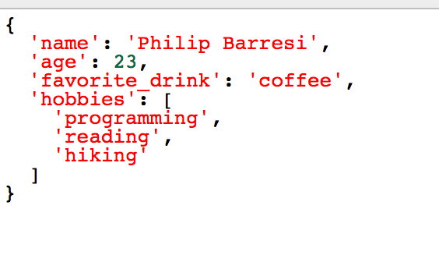
JSON?
JSON is JavaScript Object Notation, a very popular way for representing data.
Many technologies in the modern era can easily communicate with each other by using JSON as a common way of representing data between them.

Slide 12
Running a Node.js server

Slide 13
Express
Express is a very popular node package that is distributed on NPM which allows you to configure and run an entire web server.
http://expressjs.com/
Express allows you to configure different routes and how they should compose a response.
Essentially, by using the Express module, you will use code to configure a server that will listen to requests and send out responses.
This is all a web server is! It’s not magic, it’s just something that takes in requests and sends back responses!

Slide 14
What is a route?
Routing refers to determining how an application responds to a client request to a particular endpoint, which is a URI (or path) and a specific HTTP request method (GET, POST, and so on).
http://expressjs.com/en/starter/basic-routing.html
For your web applications, you will configure many routes that will each perform some action
By configuring routes, you can have the same URL perform different tasks based on having different request methods (HTTP Verbs)

Slide 15
Request Methods
There are many different types of request methods.
For this course, you will be using 4:
GET
POST
PUT
DELETE
Other methods:
https://en.wikipedia.org/wiki/Hypertext_Transfer_Protocol#Request_methods

Slide 16
GET Requests
Let us use a blog as an example.
GET requests are made when the client is requesting the representation of a resource
Location | Client is requesting… | Server is responding with…
http://myblog.com/post/2/ | The blog post with an id of 2 | An HTML document with the content of the blog post
http://myblog.com/ | The home page of the blog | An HTML document the most recent posts
http://myblog.com/editor/ | A page with an editor to write new blog posts | An HTML document with an editor to write posts in
http://myblog.com/post/2.json | The blog post with an id of 2 | A JSON document representing the content of a blog post

Slide 17
POST Requests
POST requests are made when the client is requesting to create some form of resource.
POST data comes with a message body that describes the content
Location | Client is requesting… | Server is responding with…
http://myblog.com/post/ | That a blog post be created with | An HTML document with the content of the blog post
http://myblog.com/ | The home page of the blog | An HTML document the most recent posts
http://myblog.com/editor/ | A page with an editor to write new blog posts | An HTML document with an editor to write posts in
http://myblog.com/post/2.json | The blog post with an id of 2 | A JSON document representing the content of a blog post

Slide 18
Making route modules
If you open routes/posts.js, you will see a router being created, with three routes setup; one to get a list of all posts, one to create a new post, and one to get a specific post.
A router is a set of rules that dictate how to respond to requests with particular paths and HTTP verbs.

Slide 19
General Organization
When running a server, running npm start should start your server and print a message with its address (including port).
You will have:
A file that creates, configures, and runs your server (app.js)
A folder with all your route modules (./routes)
An index file in the route folder that returns a function that attaches all your routes to your app (./routes/index.js)
Route modules (./routes/posts.js)
A folder for your data access layer modules (./data)
Your connection (./data/mongoConnection.js)
Your collection file (./data/mongoCollection.js)
Your data modules (./data/posts.js)
Potentially, an index file that exports all other data access modules

Slide 20
Requiring a folder
You may require a folder by placing a file called index.js inside the folder.
This is useful for organizing things, such as defining all your routes in a routes folder and all your data modules in a data folder.

Slide 21
Node.js as an API (GET)

Slide 22
The purpose
The purpose of our first servers will be simple: to create an API (Application Program Interface)
An API is a way to interact with a program.
We will begin with treating our servers as an access point to run our applications.
Our first server will allow us to read some blog posts that will be stored in MongoDB.

Slide 23
Seeding our database
“Seeding” a database means adding initial data.
By running npm run seed we can run a task we’ve defined in our package.json file, which will run a script that will seed our database with a single user and a single post.

Slide 24
Request data
There is a great deal of data available in a request! For now, we will be focusing on requests and only be making simple responses.
In our blog, we will be using request parameters
Request parameters are dynamic parameters we define in our route.
You should read up on the API for request data
http://expressjs.com/en/api.html#req

Slide 25
Sending a response
For now, we will only be using two response methods:
res.json(someData) will send a JSON object as the response with a status code of 200 (unless otherwise specified)
res.sendStatus(statusCode) will issue a response with the provided status code

